Slide 1
Heuristic Evaluation
November 1, 2017
Notes:
handed out paper for exercise at 2:25 (55 minutes into lecture
break at 1:40 in (only 10 minutes for teams). Pizza took time. Go faster.
Today I’m going to tell you about a useful technique in the evaluation of the DESIGN of software products…

Slide 2

Hall of Fame or Shame?
LG F7100
courtesy of Genevieve Bell, Intel
Launched in 2004 in UAE, Saudia Arabia, North Africa, India, Malaysia
Notes:
Qiblah phone
UAE, Saudia Arabia, North Africa, India Malaysia
2004

Slide 3

Hall of Fame!
LG F7100
courtesy of Genevieve Bell, Intel
Launched in 2004 in UAE, Saudia Arabia, North Africa, India, Malaysia
Good
targeted at Muslim audience
need to pray 5x/day pointing towards Mecca
Notes:
Mecca Phone

Slide 4
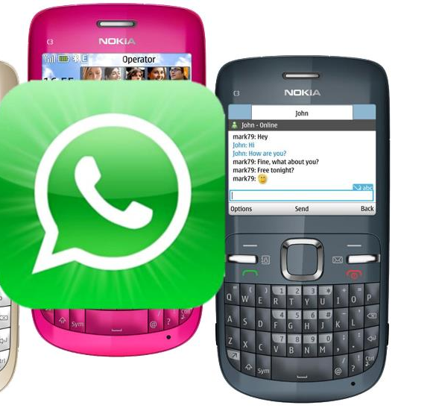
Hall of Fame or Shame?
WhatsApp
mobile messaging
Notes:
Works on some non-smart phones… allowed it to really take off in the developing world

Slide 5
Hall of Fame!
WhatsApp
mobile messaging
Good
do not have to pay expensive SMS
can contact people on other phones
works on “feature” phones → led to rapid take-off in developing world

Slide 6
Heuristic Evaluation
November 1, 2017
Notes:
[change next year: make heuristic examples animate BEFORE showing the heuristic]
handed out paper for exercise at 2:25 (55 minutes into lecture – let them work for 15 minutes
started talking about it at 2:40 and went until 2:58 – leaving 22 minutes for teams
Today I’m going to tell you about a useful technique in the evaluation of the DESIGN of software products…

Slide 7
Outline
Wizard of Oz
Heuristic Evaluation Overview
The Heuristics
Exercise
Team Break

Slide 8
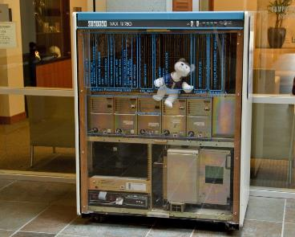
Wizard of Oz Technique
Faking the interaction. Comes from?
the film “The Wizard of OZ”
“the man behind the curtain”
Long tradition in computer industry
e.g., prototype of a PC w/ a DEC VAX behind the curtain
Notes:
1) "wizard of oz" is when you use a person or some other way to fake an interaction that has not been implemented yet. An early example of this in computing was when designing a speech-based UI, to use a human to do the recognition and even output to simulate a functioning system before it is built. Similar things have been done for handwriting recognition. Today, you could imagine that if your application needed working location-sensing features that weren't accurate enough yet or maybe even some more complicated machine learning feature that didn't exist yet, you could have a person (not the end-user) select it from a menu and have that impact the experience of a user testing your application. To the end-user it would appear as if your application worked as designed.

Slide 9
Wizard of Oz Technique
Faking the interaction. Comes from?
the film “The Wizard of OZ”
“the man behind the curtain”
Long tradition in computer industry
e.g., prototype of a PC w/ a DEC VAX behind the curtain
Much more important for hard to implement features
speech & handwriting recognition
how would we do it for VR/AR?
Notes:
2) "hard-coded features" are similar. Often, you might have an application that needs to require on a large data set (1000s of products, 100s of friends in a social network, 1000s of places with review information, etc.). None of this data may be impossible to get in practice, but for testing your user interface you may want to just "hard-code" some of this data in your app to give the flavor of how it will work (e.g., all the places are on the Stanford campus or you type in 30 products, or you simulate the friends in the social network, but all your users see the SAME list of friends) to allow you to test it or demo it.

Slide 10
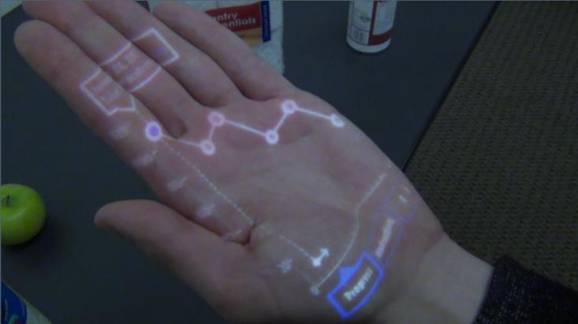
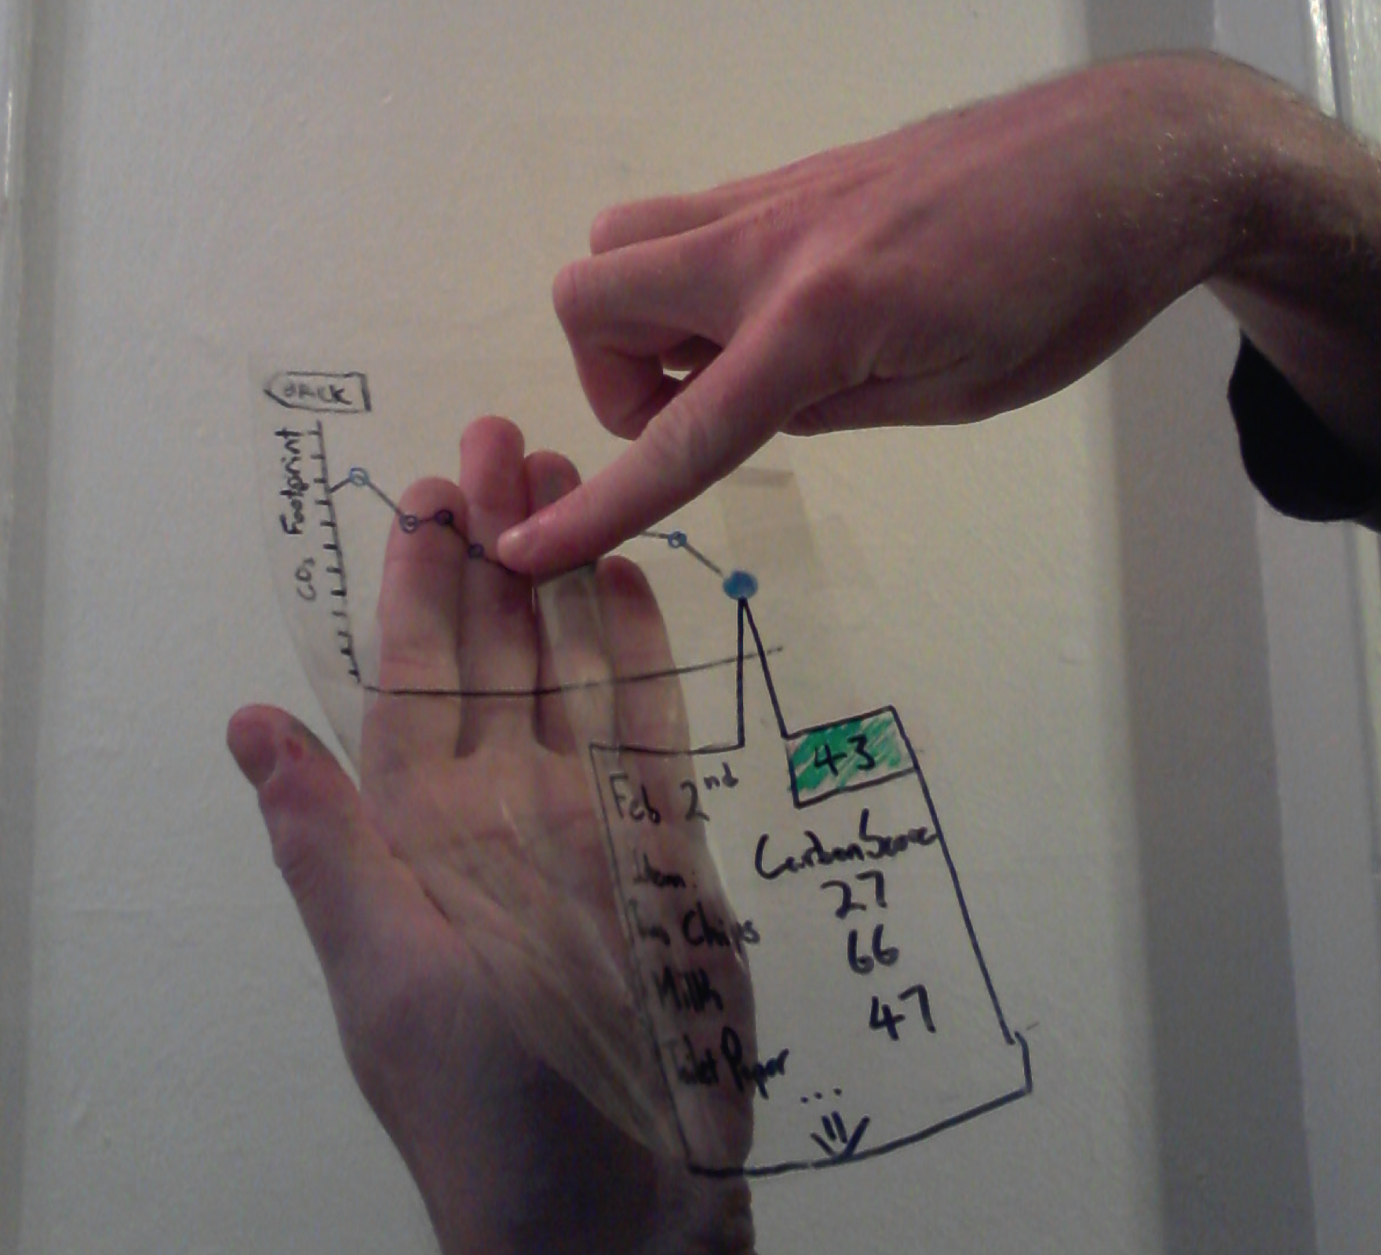
Wizard of Oz Technique
Faking the interaction. Comes from?
the film “The Wizard of OZ”
“the man behind the curtain”
Long tradition in computer industry
e.g., prototype of a PC w/ a DEC VAX behind the curtain
Much more important for hard to implement features
speech & handwriting recognition
how would we do it for VR/AR?
Carbon Shopper
Notes:
2) "hard-coded features" are similar. Often, you might have an application that needs to require on a large data set (1000s of products, 100s of friends in a social network, 1000s of places with review information, etc.). None of this data may be impossible to get in practice, but for testing your user interface you may want to just "hard-code" some of this data in your app to give the flavor of how it will work (e.g., all the places are on the Stanford campus or you type in 30 products, or you simulate the friends in the social network, but all your users see the SAME list of friends) to allow you to test it or demo it.

Slide 11
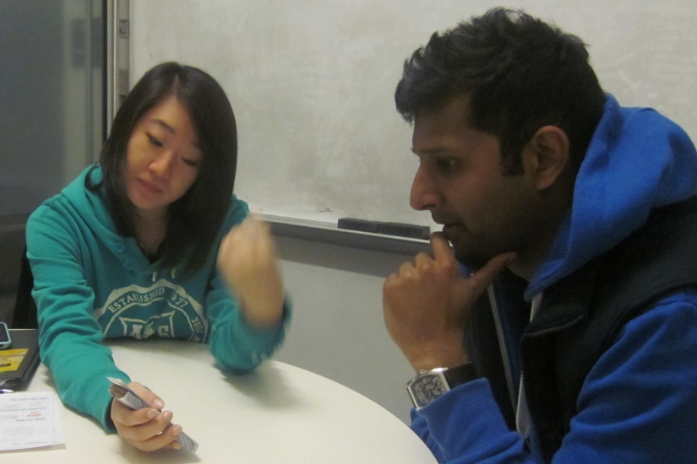
Evaluation
About figuring out how to improve design
Issues with lo-fi tests?
Notes:
Ask and THEN NEXT SLIDE

Slide 12
Evaluation
About figuring out how to improve design
Issues with lo-fi tests?
Not realistic
visuals & performance
Not on actual interface
can’t test alone
Need participants
can be hard to find repeatedly
Notes:
Issues with lo-fi:
Not realistic
Not on actual interface
Need participants

Slide 13
Heuristic Evaluation
Developed by Jakob Nielsen
Helps find usability problems in a UI design
Small set (3-5) of evaluators examine UI
independently check for compliance with usability principles (“heuristics”)
evaluators only communicate afterwards
findings are then aggregated
use violations to redesign/fix problems
Can perform on working UI or on sketches

Slide 14
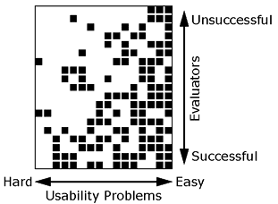
Why Multiple Evaluators?
Every evaluator doesn’t find every problem
Good evaluators find both easy & hard ones
Notes:
Meaning?
Need multiple evaluators because:
Every evaluator doesn’t find every problem
Good evaluators find both easy & hard ones

Slide 15
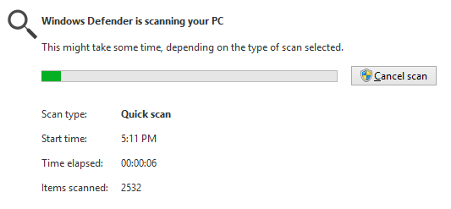

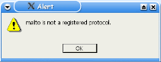
Heuristics
H1: Visibility of system status
H2: Match between system & real world
H3: User control & freedom
Notes:
DuoLingo – no way when practicing to ask to “test out” like in other parts of the UI. Need to quit & go select the function. (courtesy Armando Mota)

Slide 16
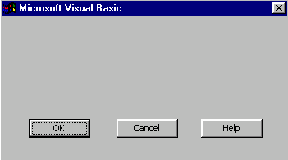
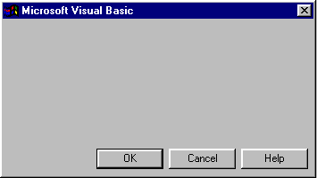
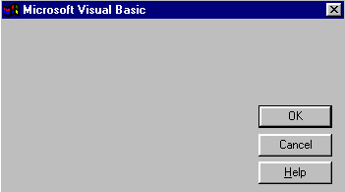
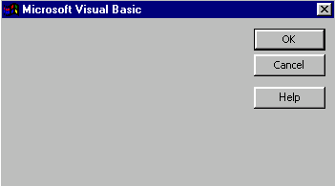
Heuristics (cont.)
H4: Consistency & standards
H5: Error prevention
H6: Recognition rather than recall
H7: Flexibility and efficiency of use
H8: Aesthetic & minimalist design
Notes:
These are all from the same UI… what’s the problem? Why? (-> consistency)

Slide 17
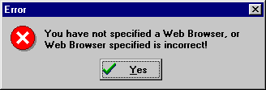
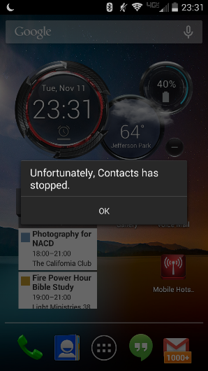
Heuristics (cont.)
bad
H9: Help users recognize, diagnose, & recover from errors
Notes:
Galaxy S4 message

Slide 18
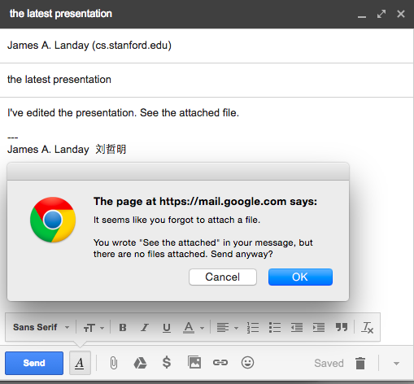
Heuristics (cont.)
good

Slide 19
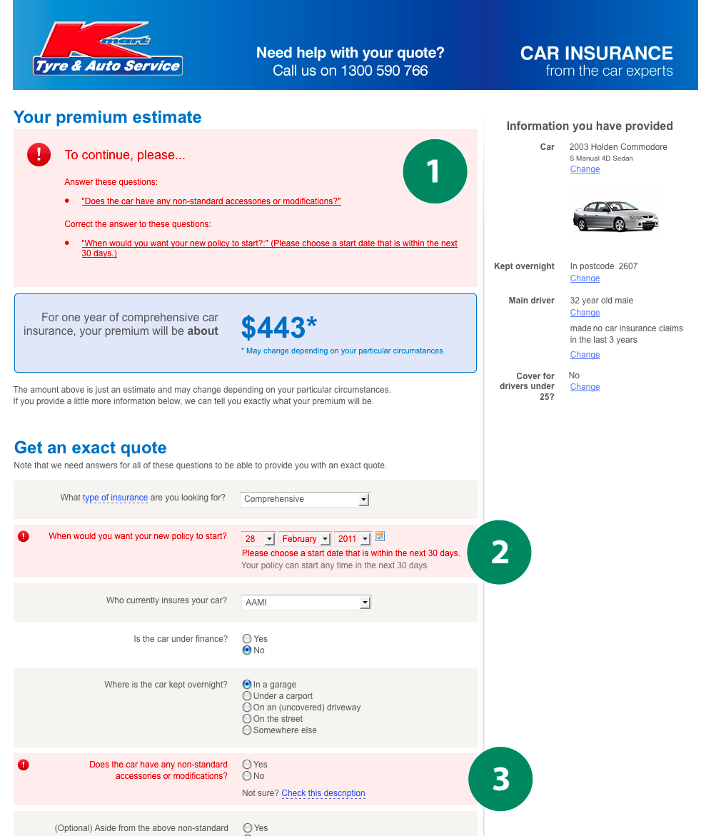
Good Error Messages
Clearly indicate what has gone wrong
Human readable
Polite
Describe the problem
Explain how to fix it
Highly noticeable

Slide 20
H10 – Help & Documentation
Better if the system can be used without documentation, but it may be necessary
How
easy to search
focused on task
list concrete steps
http://blog.screensteps.com/10-examples-of-great-end-user-documentation

Slide 21
Heuristic Violation Examples
[H6 Recognition Rather Than Recall] Can’t copy info from one window to another
user needs to memorize the data & retype
fix: allow copying
[H4 Consistency and Standards] Typography uses different fonts in 3 dialog boxes
slows users down
probably wouldn’t be found by user testing
fix: pick a single format for entire interface

Slide 22
Severity Ratings
0 - don’t agree that this is a usability problem
1 - cosmetic problem
2 - minor usability problem
3 - major usability problem; important to fix
4 - usability catastrophe; imperative to fix

Slide 23
Severity Ratings Example
1. [H4 Consistency & Standards] [Severity 3]
The interface used the string “Save” on the first screen for saving the user’s settings, but used the string “Store” on the second screen. Users may be confused by this different terminology for the same function.
Fix: Use “Save” everywhere in the application.

Slide 24
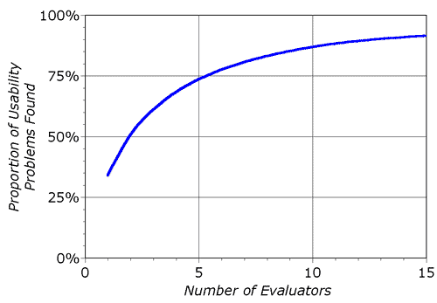
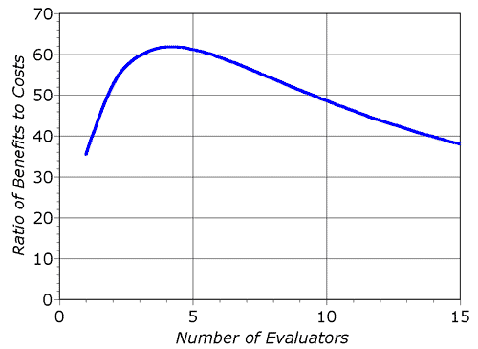
Decreasing Returns
problems found
benefits / cost
* Caveat: graphs for a specific example

Slide 25
Heuristic Evaluatoin Summary
Have evaluators go through the UI twice
Ask them to see if it complies with heuristics
note where it doesn’t & say why
Have evaluators independently rate severity
Combine the findings from 3 to 5 evaluators
come to agreement on problems, fixes & severity
Alternate with user testing

Slide 26
e x e r c i s e

Slide 27
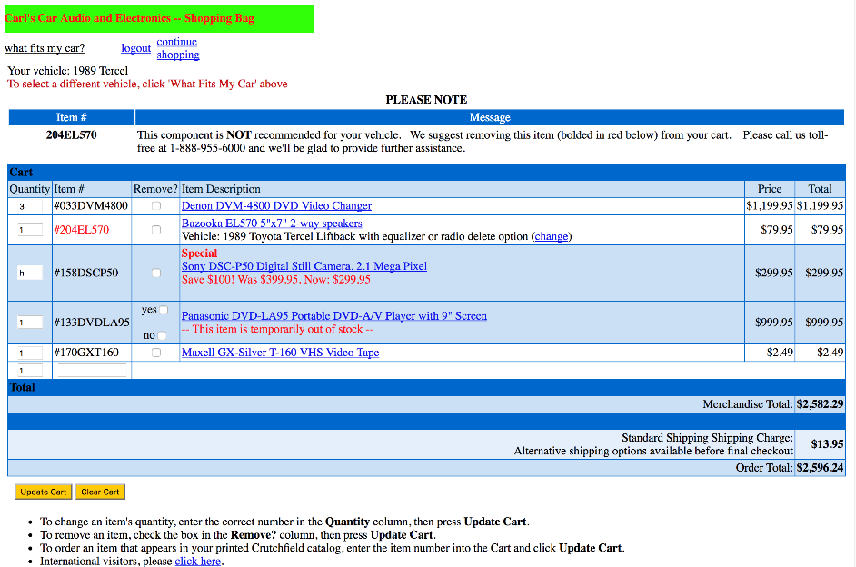
e x e r c i s e
Notes:
Let’s take 15 minutes

Slide 28
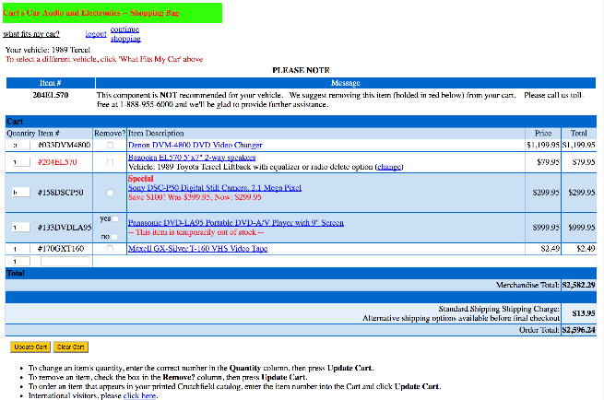
http://hci.stanford.edu/courses/cs147/2017/ au/assignments/simple-heuristic-evaluation.pdf
https://goo.gl/vkhHVy
Find 12-15 Heuristic Violations
Notes:
Let’s take 15 minutes
handed out paper for exercise at 2:25 – 55 minutes into lecture

Slide 29
Problems Found
H3 – no purchase button [100]
H4 – remove column has check boxes and then one entry w/ yes/no [100]
H5 – illegal input (text) allowed in quantity field [90]
H1 – not clear who is logged in [10]
H2 – “what fits my car” is not a good term that people would know [20]
H5 – user can add “out of stock” items [80]
Notes:
Collect and discuss problems for 10 minutes

Slide 30
Problems Found Last Year
1. H5 Error Prevention
allows non-numeric data in the quantity field. fix: don’t allow it. [90]
2. H5 Error Prevention
quantity field doesn’t multiply by the price to give a correct total. fix: make it work. [55]
3. H10 Help & Documentation
link for international visitors hidden at bottom & may not be readable by non-english speakers. fix: move up to prominent location & include flags? [30]
4. H5 Error Prevention
“Remove item bolded in red”, but red used for multiple purposes. Fix: get rid of ads in the checkout! More direct way to remove out of stock item or not even let me add a item that is out of stock. [100]
5. H5 Error Prevention
No way to check out. [110]
Notes:
Collect and discuss problems for 10 minutes

Slide 31
Problems Found Two Years Ago
H4 Consistency remove column, 4th item is different w/ checkboxes. [150]
H9 Error prevention non-numeric data in the quantity. Do not allow. [125]
H2 Match between system & real world vehicle selection link not language I’d expect [100]
H1 Visibility of System Status unclear which item to remove based on error message (“red/bold”). [150]
Notes:
Collect and discuss problems for 10 minutes

Slide 32
Further Reading Heuristic Evaluation
Longer lecture
https://drive.google.com/file/d/0BweiB6wu4sBaN2tfZGxKb2tuOTg/view
Books
Usability Engineering, by Nielsen, 1994
Web site
http://www.nngroup.com/articles/

